Slide 1
Green's function solution to subsurface light transport for BRDF computation
Charly Collin – Ke Chen – Ajit Hakke-Patil
Sumanta Pattanaik – Kadi Bouatouch

Slide 2
Painted materials:
Notes:
The main focus of our research group is to compute the reflectance of materials defined by their physical properties.
Mostly, we worked on painted materials. Those are composed of
[1] a base layer which can be concrete in the case of a painted wall, or a metal plate in the case of car paint
[2] on top of which we place a layer of transparent binder
[3] and inside this binder are pigment particles. Depending on the type of pigments, their size and their concentration, the paint color and reflection will change.

Slide 3
Painted materials:
Notes:
The BRDF at the top of this material has two components.
[1] The first one is the specular BRDF corresponding to the light reflecting directly at the surface of the material.
A lot of people have already modeled this one using Fresnel reflection or the Cook-Torrance model for example

Slide 4
Painted materials:
Notes:
The second component of the BRDF is the diffuse one. It accounts for the light entering the material, going through subsurface scattering, maybe reflecting on the base and exiting the material nearby.
Often, a Lambertian model is used to represent the diffuse BRDF
Our effort are mostly concentrated on computing this diffuse BRDF.

Slide 5
Painted materials:
Notes:
The full reflectance function for the material is then obtained by combining the two components.

Slide 6
Our goal:
Compute the diffuse BRDF from physical properties:
Base layer
Binder thickness
Particle type and distribution
$$fr\left(ω_{in},ω_{out}\right)= \frac{I(ω_{out})}{E(ω_{in})}$$
Notes:
So our goal through this work was to compute the diffuse BRDF for a material defined by:
[1] its base material
[2] the thickness of the paint layer
[3] the type and distribution of the pigment particles
[4] As any BRDF, the diffuse BRDF for two incident and outgoing directions is defined as the ratio between the radiance I exiting at the top of the paint layer and the irradiance E.

Slide 7
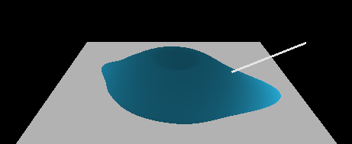
BRDF Computation
Several methods exist to compute the diffuse component:
Approximate methods:
Kubelka-Munk
Dipole model
Lam bertian model
Real-world material
Notes:
Several methods already exist to compute the diffuse component of the BRDF.
[1] Widely used ones are the Kubelka-Munk and the Dipole model. However, those are approximate method and predict a Lambertian lobe.
[2] In the context of real-world materials, the lambertian model is clearly not sufficient to accurately represent the material BRDF.

Slide 8
BRDF Computation
Several methods exist to compute the diffuse component:
Approximate methods:
Kubelka-Munk
Dipole model
Accurate methods:
Photon mapping
Monte Carlo
Adding-Doubling Method
Discrete Ordinate Method
Stochastic methods
Deterministic methods
Notes:
So we need accurate methods to compute realistic diffuse BRDF.
[1] Existing methods can be separated in two categories. Some of them are stochastic, such as photon mapping or monte carlo based methods, and others, like the Adding-Doubling or the Discrete Ordinate method are deterministic method.
Accurate methods are expensive. Especially the Stochastic ones in the case of highly scattering materials. But we want to compute an accurate diffuse BRDF.
In an attempt to improve the efficiency of this computation, we propose a Green’s function based approach to solving the Discrete Ordinate Method

Slide 9
BRDF Computation
Our computation makes several assumptions on the material:
Plane parallel medium
$$I(ω_{out})$$
$$I(ω_{out})$$
Notes:
Our BRDF computation assumes several properties for the material.
[1] First we assume a plane paralllr medium. This means that the radiance I in a given direction changes only with the depth, and therefore is constants on a horizontal plane.

Slide 10
BRDF Computation
Our computation makes several assumptions on the material:
Plane parallel medium
Randomly oriented particles
$$ω=(μ,φ)$$
$$fr\left(μ_{in},φ_{in},μ_{out}{,φ}_{out}\right)=fr\left(μ_{in},μ_{out}{,φ_{in}−φ}_{out}\right)$$
Notes:
The second assumption is that the particles inside our medium are randomly oriented. This means that if we decompose a direction into the cosine of its zenith angle and its azimuth angle, respectively mu and phi, the BRDF becomes a function of only 3 parameters: The incident and outgoing zenith angle, and the difference between the two azimuth angles.

Slide 11
BRDF Computation
Our computation makes several assumptions on the material:
Plane parallel medium
Randomly oriented particles
Homogeneous layers
$$I(ω_{out})$$
$$I(ω_{out})$$
Notes:
Finally we assume that the material is homogeneous. This means that the material properties are constants within the layer.
Heterogeneous materials are approximated through a supperposition of homogeneous layers.

Slide 12
BRDF Computation
BRDF computation requires computing the radiance field at the top of the material
$$I_{inc}$$
$$I(ω_{out})$$
The radiance field is modeled as a solution to the Radiative Transfer Equation
Notes:
Now that our material is defined, the diffuse BRDF computation requires computing the radiance field at the top of the material. This means computing the radiance at the surface of the top layer for each outgoing direction. Moreover, this computation needs to be conducted for each incident direction.
[1] Given a incident direction, the radiance field is modeled as a solution to the radiave transfer equation.

Slide 13
Radiative Transfer Equation
$$μ\frac{∂}{∂τ}I\left(τ,ω\right)=−I\left(τ,ω\right)+J\left(τ,ω\right)+Q\left(τ,ω,ω_{in}\right)$$
RTE expresses the change of radiance along optical depth $τ$.
It has 3 components:
$I\left(τ,ω\right)$ the radiance
$J\left(τ,ω\right)$ corresponding to the light scattering inside the material
$$J\left(τ,ω\right)= \frac{α}{4π}\int_{−1}^{1}{p\left(τ,ω,ω′ \right)I\left(τ,ω′ \right)dω′}$$
$$J\left(τ,ω\right)$$
$$I\left(τ,ω′ \right)$$
$$τ$$
Notes:
This Radiative Transfer Equation, or RTE, expresses the change of radiance along the optical depth Tau.
This change is expressed through 3 components:
[1] First component is I, the radiance, at a depth Tau along a direction Omega.
[2] The second component is the function J corresponding to the in-scattering of light inside the material. J is expressed using the single scattering albedo Alpha, and the phase function p

Slide 14
Radiative Transfer Equation
$$μ\frac{∂}{∂τ}I\left(τ,ω\right)=−I\left(τ,ω\right)+J\left(τ,ω\right)+Q\left(τ,ω,ω_{in}\right)$$
RTE expresses the change of radiance along optical depth $τ$.
It has 3 components:
$I\left(τ,ω\right)$ the radiance
$J\left(τ,ω\right)$ corresponding to the light scattering inside the material
$Q\left(τ,ω,ω_{in}\right)$ accounting for attenuated incident radiance
$Q\left(τ,ω\right)= \frac{αI_{in}}{4π} p(τ,ω_{in},ω)e^{−τ/{μ_{in}}}$
$$I_{inc}$$
$Q\left(τ,ω\right)$
$$τ$$
Notes:
The third component of the RTE is the source function Q, accounting for the attenuated incident radiance.
This component corresponds to the lighting condition of the material

Slide 15
Radiative Transfer Equation
$$μ\frac{∂}{∂τ}I\left(τ,ω\right)=−I\left(τ,ω\right)+J\left(τ,ω\right)+Q\left(τ,ω,ω_{in}\right)$$
RTE expresses the change of radiance along optical depth $τ$.
It has 3 components:
$I\left(τ,ω\right)$ the radiance
$J\left(τ,ω\right)$ corresponding to the light scattering inside the material
$Q\left(τ,ω,ω_{in}\right)$ accounting for attenuated incident radiance
To compute the BRDF, RTE needs to be solved for each incident and
outgoing direction.
Notes:
Ultimately, we need to compute the radiance field for the whole thickness, and this computation needs to be repeated for each incident and outgoing direction.

Slide 16
RTE Solution
Fourier expansion of the radiance
$$I\left(τ,ω\right)= \frac{1}{2}I^{0}\left(τ,μ\right)+\sum_{m=1}^{L}{I^{m}\left(τ,μ\right)cos⁡(mφ)}$$
$$ω=(μ,φ)$$
Notes:
But how to solve this RTE?
[1] First we use a Fourier expansion of the radiance. This allows us to separate the zenith and azimuth angle dependancy of the radiance. For each order of expansion, Im is independant of phi.

Slide 17
RTE Solution
The RTE for each expansion order can be written as:
$$μ\frac{∂}{∂τ}I^{m}\left(τ,μ\right)={−I}^{m}\left(τ,μ\right)+\frac{ω}{2}\int_{−1}^{1}{p^{m}(μ,μ′) I^{m}\left(τ,μ^{′}\right)dμ′}+Q^{m}\left(τ,μ,μ_{in}\right)$$
That we reorganize:
Components expressed using $I^{m}$
$$μ\frac{∂}{∂τ}I^{m}\left(τ,μ\right){+I}^{m}\left(τ,μ\right)−\frac{ω}{2}\int_{−1}^{1}{p^{m}\left(μ,μ^{′}\right)I^{m}\left(τ,μ^{′}\right)dμ^{′}}=Q^{m}\left(τ,μ,μ_{in}\right)$$
Components independant of $μ_{in}$
Notes:
The Radiative transfer equation can be rewritten for each order of expansion.
[1] To simplify the notations, we reorganize the RTE by writing all the components expressed in function of the radiance I on the left side of the equal sign.
[2] We can note that coincidently, this corresponds to the components that are independant of the incident direction mu in

Slide 18
RTE Solution
$$μ\frac{∂}{∂τ}I^{m}\left(τ,μ\right){+I}^{m}\left(τ,μ\right)−\frac{ω}{2}\int_{−1}^{1}{p^{m}\left(μ,μ^{′}\right)I^{m}\left(τ,μ^{′}\right)dμ^{′}}=Q^{m}\left(τ,μ,μ_{in}\right)$$
We introduce an integro-differential operator $ℒ$:
$$ℒ\left[I^{m}\left(τ,μ \right)\right]= Q^{m}(τ,μ,μ_{in})$$
Needs to be solved for each $μ_{in}$ and $μ$
Notes:
Having all the components function of the radiance on the left, we can recognize an integro-differential equation
[1] and introduce an integro differential operator L such that L of the radiance is the source function
[2] To compute the BRDF, this differential equation needs to be solved for each incident and outgoing zenith angle

Slide 19
RTE Solution
Standard solution is the combination of the homogeneous solution...
$$ℒ\left[I_{h}^{m} \left(τ,μ_{i}\right)\right]=0$$
... and one particular solution.
$$ℒ\left[I_{p}^{m} \left(τ,μ_{i}\right)\right]= Q^{m}\left(τ,μ,μ_{in}\right)$$
$I^{m}\left(τ,μ_{i}\right)=$ $I_{h}^{m} \left(τ,μ_{i}\right)$ + $I_{p}^{m} \left(τ,μ_{i}\right)$
Notes:
Following standard practice in differential equation litterature, such a solution is computed as the combination of
[1] the homogeneous solution, which is the solution to the equation where the source function has been cancelled
[2] and one particular solution satisfying the full RTE
The homogeneous solution has unknown constants which will be defined once a particular solution has been found.

Slide 20
RTE Solution
The homogeneous solution is independant of $μ_{in}$
It can be solved only once for each $μ$
The particular solution depends on $Q^{m}$
Its computation must be repeated for each incident direction!
How to take advantage of the similarity of the computations?
Notes:
So computing the BRDF by solving the RTE means
[1] Computing the homogeneous solution Ih. As it is independent of the incident radiance,
[2] this homogeneous solution needs to be solved only once for each outgoing direction
[3] Then a particular solution needs to be computed. This solution depends on the source function Q, so the computation of the particular solution needs not only to be repeated for each direction mu,
[4] but also for each incident direction. We have here a large repetition of very similar computations.
[5] So is there any way to take advantage of that similarity?

Slide 21
Green’s function solution
For a generic differential equation:
$$ℱ\left[f\left(x\right)\right]=q(x)$$
Green’s function are defined as:
$$ℱ\left[G (x:t)\right]= δ(t−x)$$
Property of the $δ$ function:
$$\int_{a}^{b}{δ\left(t −x\right)dt}=1$$
$$\int_{a}^{b}{δ\left(t −x\right)q(t)dt}=q(x)$$
$$\int_{a}^{b}{ℱ\left[G (x:t)\right]q(t)dt}=q(x)$$
Notes:
One way of finding a particular solution is through the use of Green’s function. Let me introduce the Green’s function through a generic problem.
[1] Let’s consider a generic differential equation represented by the operator F here.
[2] The Green’s function associated with this differential equation is defined by this equation (show the equation on screen). Note that the Green’s function G is defined on a larger dimension space than the function f if the original equation.
[3] The delta function has the property of having its integral equal to 1
[4] When integrated with the source function q, the integral is equal to q(x)
[5] So the integration of the Green’s function times the source function is equal to the source function evaluated on x

Slide 22
Green’s function solution
$$\int_{a}^{b}{ℱ\left[G (x:t)\right]q(t)dt}=q(x)$$
$$ℱ\left[f\left(x\right)\right]=q(x)$$
$$ℱ\left[G (x:t)\right]= δ(t−x)$$
Considering a particular solution $f_{p}$:
$$ℱ\left[f_{p}\left(x\right)\right]=q(x)$$
Leading to the equality:
$$\int_{a}^{b}{ℱ\left[G (x:t)\right]q(t)dt}=ℱ\left[f_{p}\left(x\right)\right]$$
$$ℱ\left[\int_{a}^{b}{G(x:t)q(t)dt}\right]=ℱ\left[f_{p}\left(x\right)\right]$$
$$\int_{a}^{b}{G(x:t)q(t)dt}=f_{p}\left(x\right)$$
Notes:
Let me rewrite these equations at the top of the slide.
Now, we want to use this Green’s function to compute a particular solution to our differential equation.
[1] As seen earlier, a particular solution fp satisfies this equation (show on screen)
[2] We have an equality here between our particular solution and the integral of the Green’s function
[3] We can take the operator L outside the integral on the left part of the equation
[4] And finally express the particular solution as the integration of the Green’s function G multiplied by the source function q.
This is one of the interesting properties of the Green’s function. Once we know G, a particular solution can be computed for any source function q simply by evaluating the integral.

Slide 23
Green’s function solution
How to compute $G(x:t)$?
$$ℱ\left[G(x:t)\right]= δ(t−x)$$
For any $x≠t$:
$$ℱ\left[G(x≠t:t)\right]=0$$
Homogeneous equation!
For $x=t$, use of a jump condition:
$$\int_{t−ε}^{t+ε}{ℱ\left[G(x:t)\right]dx= \int_{t−ε}^{t+ε}{δ\left(t−x\right)dx}}$$
$$G\left(t+ε:t\right)−G\left(t−ε:t\right)=1$$
The Green’s function can be expressed using only the homogeneous solution
Notes:
So we know how to compute the particula solution using the Green’s function, but how to compute G? Let me remind you the definition of the Green’s function.
[1] When we apply the operator F on the Green’s function, we obtain a delta function.
[2] If we pick any point x different from t, this delta function gets canceled.
[3] We fall back here on an homogeneous equation. So for any x different from t, the Green’s function is the homogeneous solution to the differential equation ! The only part left is the value of G for x equals t.
[4] For this particular case, we use a jump condition obtained by integrating the differential equation around t. Giving us a very simple condition.
[5] So this means that the Green’s function can be expressed using only the homogeneous solution to the differential equation.

Slide 24
Back to the RTE
$$μ\frac{∂}{∂τ}I^{m}\left(τ,μ\right){+I}^{m}\left(τ,μ\right)−\frac{ω}{2}\int_{−1}^{1}{p^{m}\left(μ,μ^{′}\right)I^{m}\left(τ,μ^{′}\right)dμ^{′}}=Q^{m}\left(τ,μ,μ_{in}\right)$$
$$ℒ\left[I^{m}\left(τ,μ \right)\right]= Q^{m}(τ,μ,μ_{in})$$
In this case the Green’s function is defined as a 4-D function:
$$ℒ\left[G^{m}\left(τ,μ :t,μ′\right)\right]=δ(t−τ)δ(μ^{′}−μ)$$
And our particular solution can be expressed as:
$$\int_{0}^{τ_{max}}{\int_{−1}^{1}{G^{m}\left(τ,μ :t,μ^{′}\right)}}Q^{m}\left(t,μ^{′}\right)=I_{p}^{m} \left(τ,μ\right)$$
Notes:
So we saw how to compute a particular solution to a generic differential equation using Green’s function. How does it relate to our RTE?
[1] Let me remind you the form of the RTE. As we saw earlier, the radiance I is a function of two parameters: Tau the optical depth and mu the zenith angle
[2] The Green’s function associated to this problem is now a function of 4 parameters, and when we appy the integro-differential operator L on G, the result is 2 delta function, one for each parameter of I
[3] Finally, a particular solution to the RTE is expressed through a double integral of the Green’s function multiplied by our source funtion Q.

Slide 25
Back to the RTE
$$ℒ\left[G^{m}\left(τ≠t,μ :t,μ′\right)\right]=0$$
Using the homogeneous solution$I_{h}^{m} \left(τ,μ_{i}\right)$, we can express:
$$G^{m}\left(τ<t,μ :t,μ′\right)$$
and
$$G^{m}\left(τ>t,μ :t,μ′\right)$$
The jump condition becomes:
$$μ\left[G^{m}\left(t+ε,μ :t,μ′ \right)−G^{m}\left(t−ε,μ :t,μ′ \right)\right]= δ(μ′−μ)$$
Notes:
As earlier, for each Tau different from t, the Green’s function definition is an homogeneous equation.
[1] This means that using the homogeneous solution Ih to the RTE, we can express the Green’s function G for any Tau lower or higher than t
[2] The value of G for Tau equals t, is obtained by the jump condition which in this case becomes (show the equation on screen)

Slide 26
RTE Solution
The homogeneous solution is independant of $μ_{in}$
It is solved only once
The Green’s function can be expressed using
$$I_{h}^{m} \left(τ,μ_{i}\right)$$
The particular solution is now an integration of the Green’s function
Notes:
So using a Green’s function based solution, solving the RTE consists of:
[1] Computing the homogeneous solution. As earlier, it is independant of the incident direction mu in
[2] Therefore, it needs to be solved only once for each outgoing direction
[3] As we know the homogeneous solution, we can express the Green’s function G
[4] And now, for each incident and outgoing direction, a particular solution can be computed through the integration of the Green’s function.

Slide 27
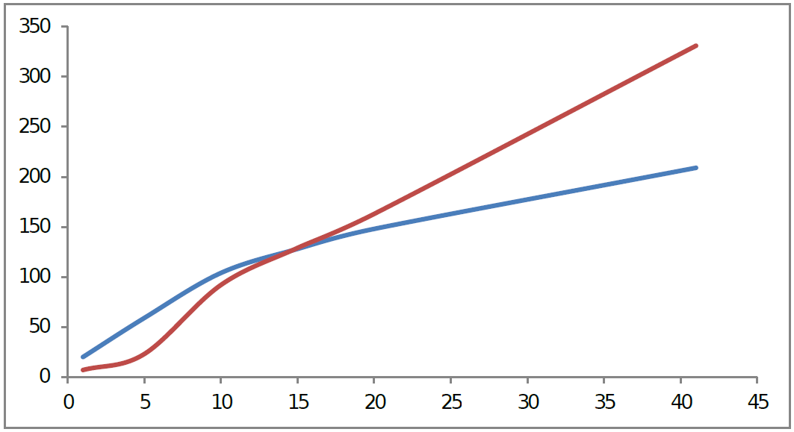
Is it faster?
Without Green’s function
Time
Using Green’s function
Number of incident directions
Time needed to compute the particular solution
Notes:
Through the use of Green’s function, we wanted to make the computation of the RTE solution faster. But is it the case?
Well, it depends of the number of incident direction considered. This graph shows the time needed to compute the particular solution of the RTE as a function of the number of incident directions. In blue we have the time spent using the Green’s function, whereas in red is the time spent using a traditional substitution technique.
For a small number of incident directions, going through the computation of Green’s function is not interesting.
This is because the computation of the Green’s function adds an extra overhead which is amortized only for larger number of incident direction. We can see here that in practice, using Green’s function is interesting starting from 15 different incident directions.
Let me remind you though that the problem we are addressing here is the computation of a BRDF, and accurate BRDF computation requires solving the radiance field for a large number of directions. So for this problem, the Green’s function based solution does provide an overall acceleration of the computation.

Slide 28
Results
That DOM solution can be used for computing subsurface BRDF
for different pigment particles types
Notes:
We can then use our method to compute the diffuse BRDF for different pigment particles.
Here the same paint layer is used, as well as the same particle distribution inside that layer. Only the type of the particles changes.
On the left, we used gold particles, in the middle, silver particles, and finally on the right copper particles.
TODO: update images

Slide 29
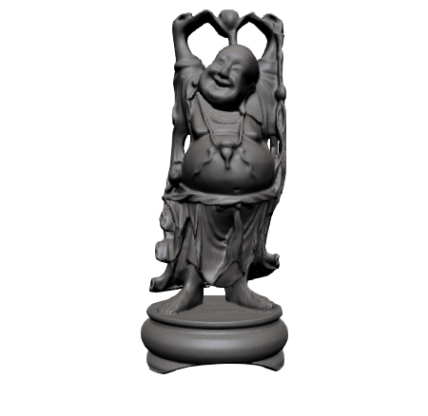
Results
BRDF will change as well for different material thicknesses
Notes:
Another property of our material is the thickness of the layer, here we use the diffuse BRDF for a paint composed of titanium dioxyde particles. From left to right, the thickness of the paint layer increases, going from an optical thicknes of 0.1 to an infinite optical thickness, meaning that the light never reaches the bottom of the paint layer.

Slide 30
Results
The solution handles materials with multiple layers.
Notes:
Finally, we can supperpose several homogeneous layers. Here the base is painted using paint with titanium dioxyde particles, on which a thin layer of paint containing titanium nitride has been added to recreate the SCCG logo.

Slide 31
Thank you
Notes:
Thank you for your attention. If you have any question I would be pleased to anwer them.

